Slide 1
YEt Another Highspeed TCP
Satyam Prakash
M.Tech CSE

Slide 2
What is YeAH?
YeAH (Yet Another High-speed) is a high speed TCP congestion control algorithm.
Standard TCP is successful at low speeds but it is unfit for high speed communication due to slow ramp-up of congestion window size. For high bandwidth connectivity high speed congestion control algorithms are used.
YeAH was presented by Baiocchi et al in 2007.
For indication of network congestion, it uses a mixed loss-delay-based strategy.
It is similar in spirit of TCP Africa and Compound TCP.
Purpose is to get high efficiency, fairness and reducing link loss without inducing stress to network elements .
Definition Credit : https://ieeexplore.ieee.org/document/1378080

Slide 3
What are congestion control algorithms?
What is congestion?
Congestion is a network state in which intermediate devices such as routers drop the packet due to overflow in buffers.
Congestion control refers to the mechanisms and techniques to control congestion and keep the load below the capacity.
Congestion control was not part of original TCP design. It was added in 1980s.
Congestion control algorithm are strategies used by TCP to avoid sending data more than capability of network. They avoid causing network congestion.
Definition Credit - http://www.idc-online.com › data_communications.pdf

Slide 4
Goals of YeAH
Network capacity should be exploited efficiently. It can be achieved by modifying the congestion window update rules by exploiting anyone of the increment rules of other algorithm like Scalable TCP or Highspeed TCP.
The stress induced to the network should be less or equal than that induced by Reno TCP.
It should compete fairly with Reno traffic flows.
The algorithm should be internally and RTT fair.
Performance should not significantly reduce by lossy links.
Small link buffers should not prevent high performance.

Slide 5
Modes of Operation in YeAH
To address all goals YeAH is operated in two different modes:
Fast Mode : During fast mode it increments the congestion window according to aggressive Scalable TCP rule. In Scalable TCP congestion window is incremented by 0.01 per acknowledgement received. It takes only 70 RTTs to double the sending rate irrespective of any rate.
Slow Mode : During slow mode it acts similarly to Reno TCP.

Slide 6
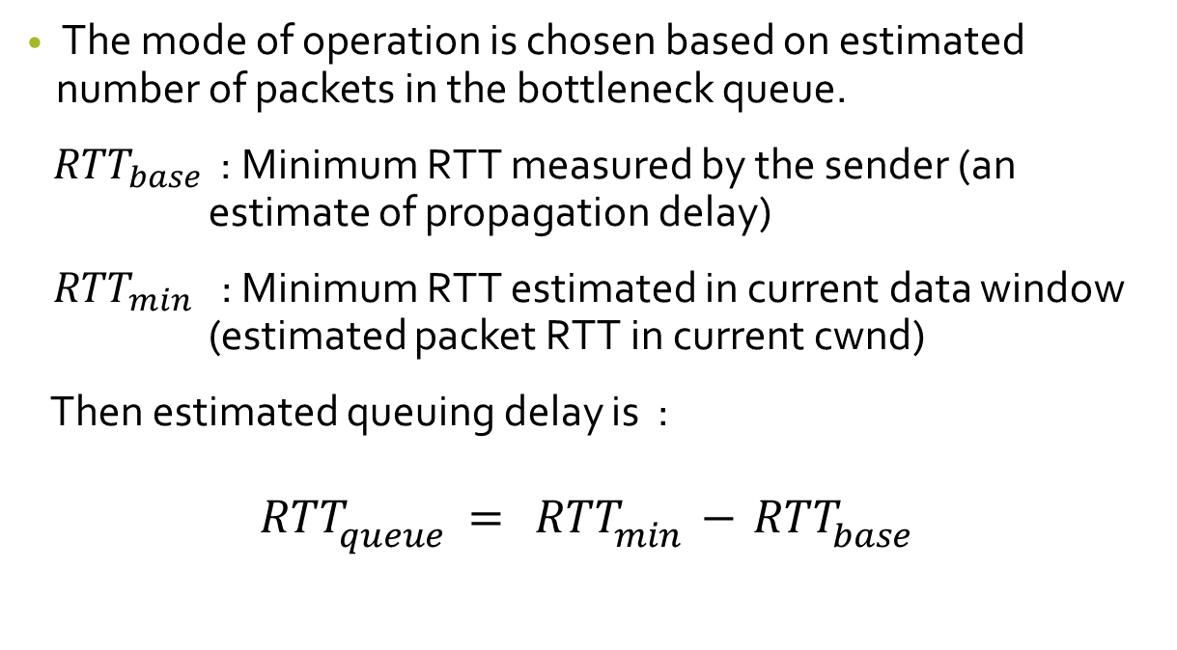
Modes of Operation (contd..)
The mode of operation is chosen based on estimated number of packets in the bottleneck queue.
${RTT}_{base }$ : Minimum RTT measured by the sender (an estimate of propagation delay)
${RTT}_{min}$ : Minimum RTT estimated in current data window (estimated packet RTT in current cwnd)
Then estimated queuing delay is :
$${RTT}_{queue}= {RTT}_{min}−{RTT}_{base}$$
Equation Credit - http://www.csc.lsu.edu/~sjpark/cs7601/4-YeAH_TCP.pdf

Slide 7
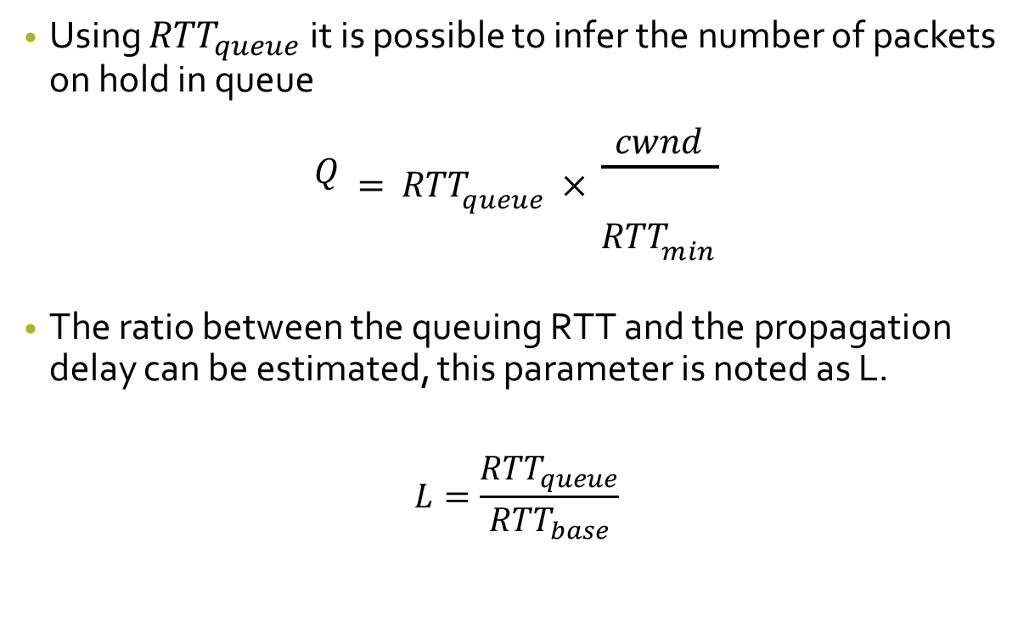
Modes of Operation (contd..)
Using ${RTT}_{queue}$it is possible to infer the number of packets on hold in queue
$$Q={RTT}_{queue}×\frac{cwnd}{{RTT}_{min}}$$
The ratio between the queuing RTT and the propagation delay can be estimated, this parameter is noted as L.
$$L=\frac{{RTT}_{queue}}{{RTT}_{base}}$$

Slide 8
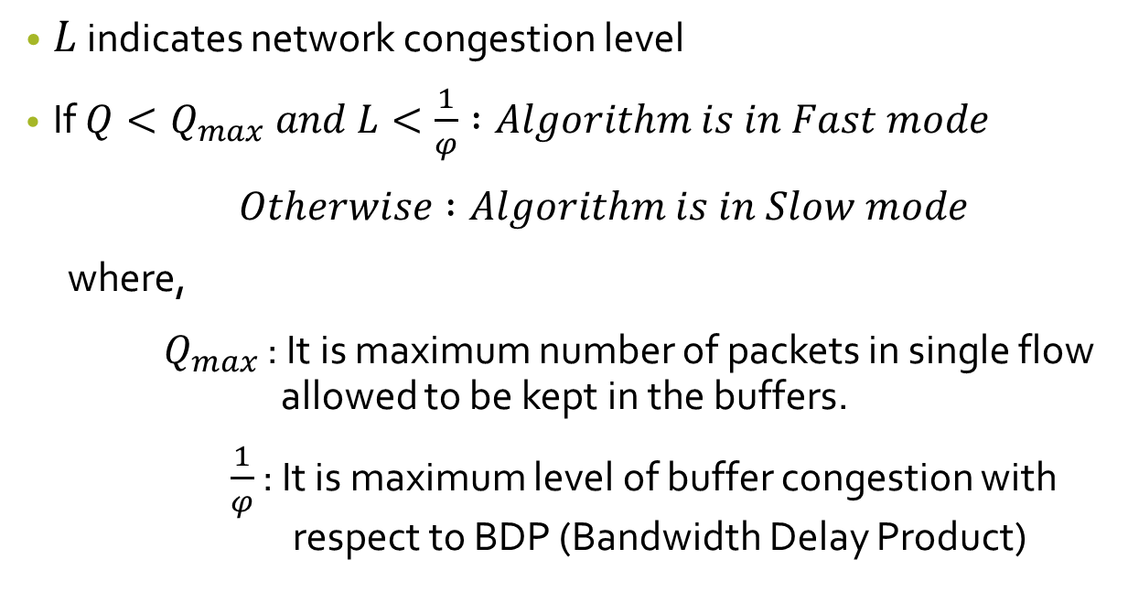
Modes of Operation (contd..)
$L$ indicates network congestion level
If $Q<Q_{max} and L<\frac{1}{φ} :Algorithm is in Fast mode$
$Otherwise :Algorithm is in Slow mode$
where,
$Q_{max}$ : It is maximum number of packets in single flow allowed to be kept in the buffers.
$\frac{1}{φ}$ : It is maximum level of buffer congestion with respect to BDP (Bandwidth Delay Product)

Slide 9
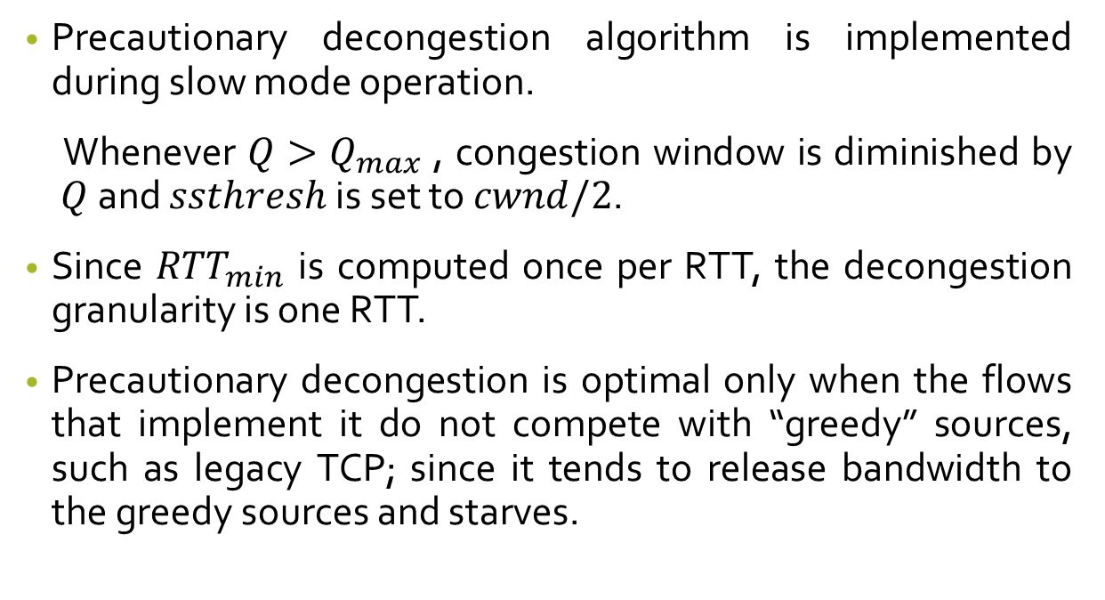
YeAH(contd..)
Precautionary decongestion algorithm is implemented during slow mode operation.
Whenever $Q>Q_{max}$ , congestion window is diminished by $Q$ and $ssthresh$ is set to $cwnd/2$.
Since ${RTT}_{min}$ is computed once per RTT, the decongestion granularity is one RTT.
Precautionary decongestion is optimal only when the flows that implement it do not compete with “greedy” sources, such as legacy TCP; since it tends to release bandwidth to the greedy sources and starves.

Slide 10
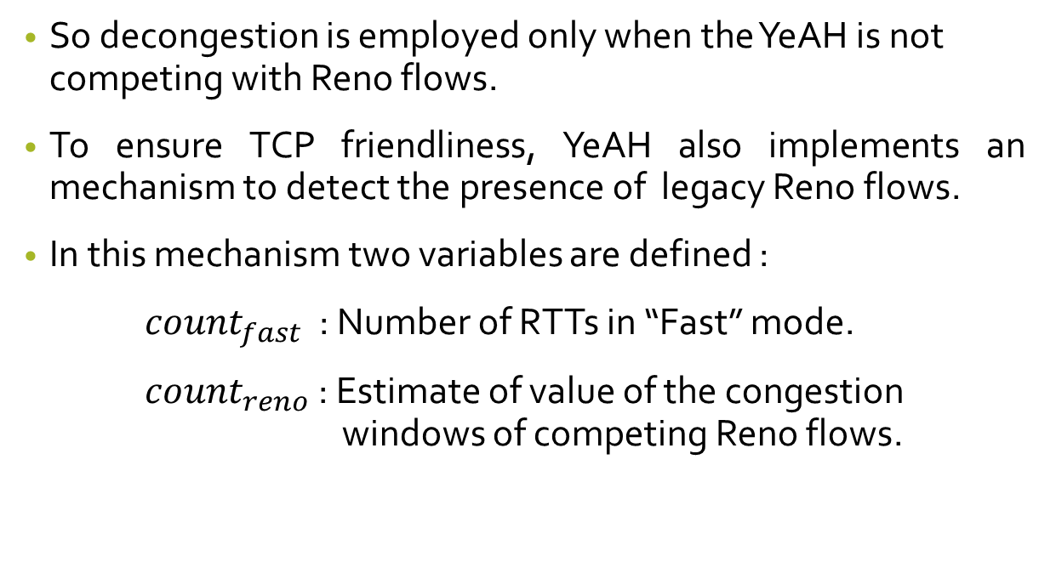
YeAH(contd..)
So decongestion is employed only when the YeAH is not competing with Reno flows.
To ensure TCP friendliness, YeAH also implements an mechanism to detect the presence of legacy Reno flows.
In this mechanism two variables are defined :
${count}_{fast}$ : Number of RTTs in “Fast” mode.
${count}_{reno}$ : Estimate of value of the congestion windows of competing Reno flows.

Slide 11
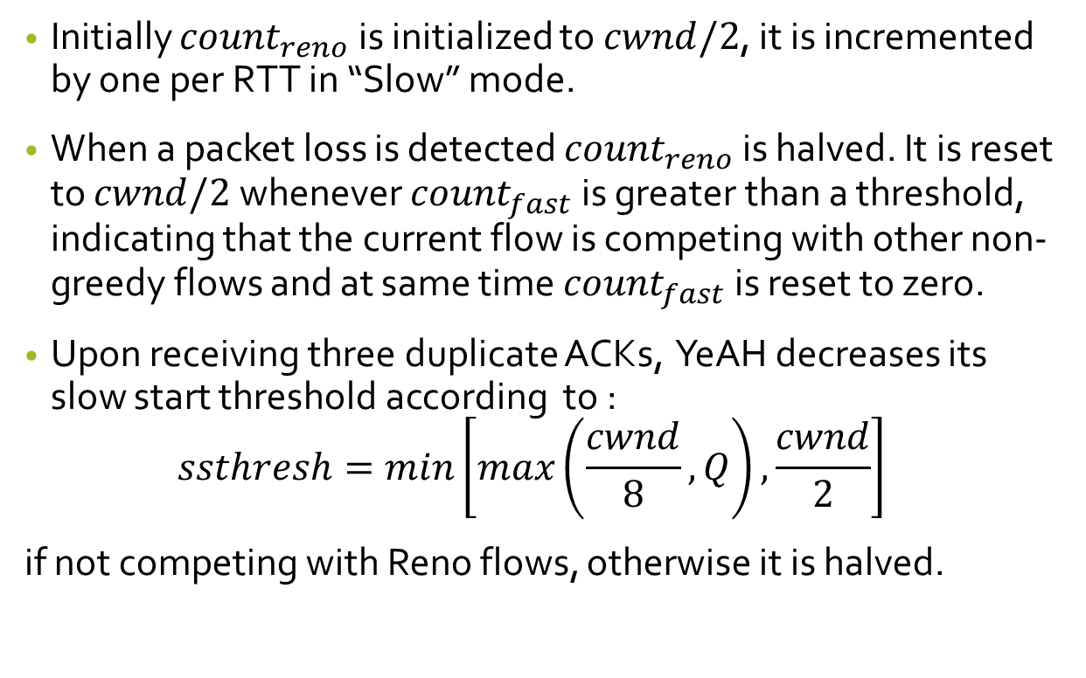
YeAH(contd..)
Initially ${count}_{reno}$ is initialized to $cwnd/2$, it is incremented by one per RTT in “Slow” mode.
When a packet loss is detected ${count}_{reno}$ is halved. It is reset to $cwnd/2$ whenever ${count}_{fast}$ is greater than a threshold, indicating that the current flow is competing with other non-greedy flows and at same time ${count}_{fast}$ is reset to zero.
Upon receiving three duplicate ACKs, YeAH decreases its slow start threshold according to :
$$ssthresh=min\left[max\left(\frac{cwnd}{8},Q\right), \frac{cwnd}{2}\right]$$
if not competing with Reno flows, otherwise it is halved.

Slide 12
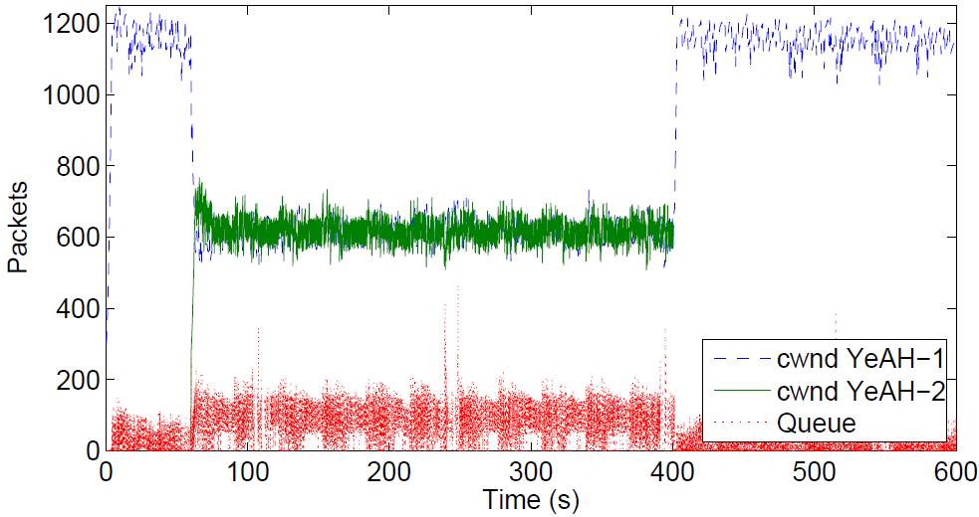
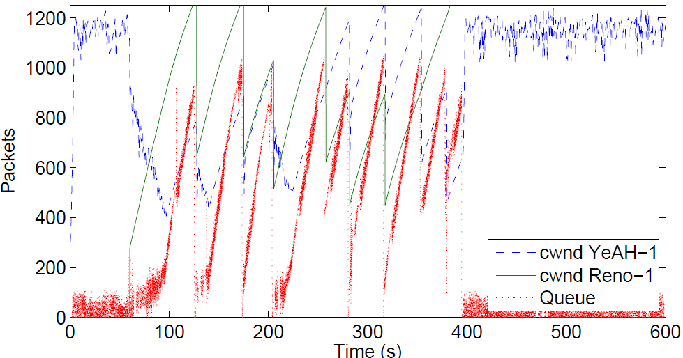
YeAH vs YeAH flow
YeAH vs Reno flow
When second YeAH-TCP flow starts, the two flows converge steeply towards the same congestion window.
When the legacy TCP flow starts, the YeAH-TCP decrements the congestion window until it gets aware to compete with a “greedy” flow and from this moment on, the two flows share the bandwidth in the Reno way.
Image Credit - http://www.csc.lsu.edu/~sjpark/cs7601/4-YeAH_TCP.pdf

Slide 13
Characteristics of YeAH
YeAH always offer low load while fully utilizing the link. This characteristic is achieved due to precautionary queue decongestion algorithm.
YeAH performance is not affected by lower buffer sizes due to its fixed buffer requirement.
If link loss probability is high then other algorithms throughput is highly impacted whereas is able to sustain higher throughput than others because it does not reduces cwnd according to a constant factor, but depends on estimated BDP.

Slide 14
Characteristics of YeAH (contd..)
YeAH TCP is Reno friendly since its “fast component” is disabled when competing with Reno flows and its behavior is similar to Reno one.
YeAH is proved to be RTT fair, it is because every flow tries to keep in the bottleneck buffer a fixed number of packets, whatever be the RTT, thus every flow gets a fair share of the bottleneck.

Slide 15
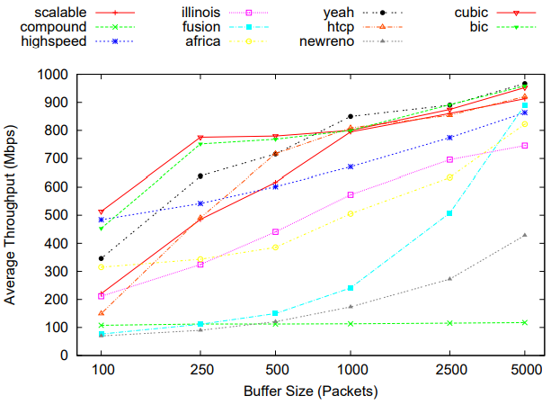
Characteristics of YeAH (contd..)
When the buffer size is very large then throughput of YeAH is better than all other algorithms. This is due to gentle reduction in cwnd whenever loss is detected.
Image Credit : https://arxiv.org/pdf/1610.03534.pdf

Slide 16
Disadvantage of YeAH
It has some preset variables make it more static and needs a different setting for each network scenario. The existence of these preset variables makes the implementation more harder and reduces its adaptation capabilities to fit different scenarios without any manual changes.
YeAH show huge burst loss. Burst loss is a problem in slow start which happens at the end of the initial stage of slow start. Cause of this burst loss is exponential increase of the congestion window in order to quickly utilize the bandwidth. The burst loss can dangerously congest the bottleneck and may lead to slow down the performance of TCP.
Definition Credit : https://arxiv.org/pdf/1610.03534.pdf

Slide 17
Conclusion
YeAH TCP is efficient in exploiting the available bandwidth, without inducing stress to network elements. This is internally and RTT fair, TCP Reno friendly and reacts correctly to packet losses independent of congestion.

